Slide 1
Case Study
Bikeleasing Reporting Interface

Slide 2
A Deep Dive into the Reporting Interface Challenge
Infrastructure Overview
Hub and spoke architecture
Application flow overview
CI/CD Pipeline
Deployment strategy
Rollback mechanisms and Feedback loop
Scalability and Performance
Monitoring and Observability
Security & Compliance

Slide 3
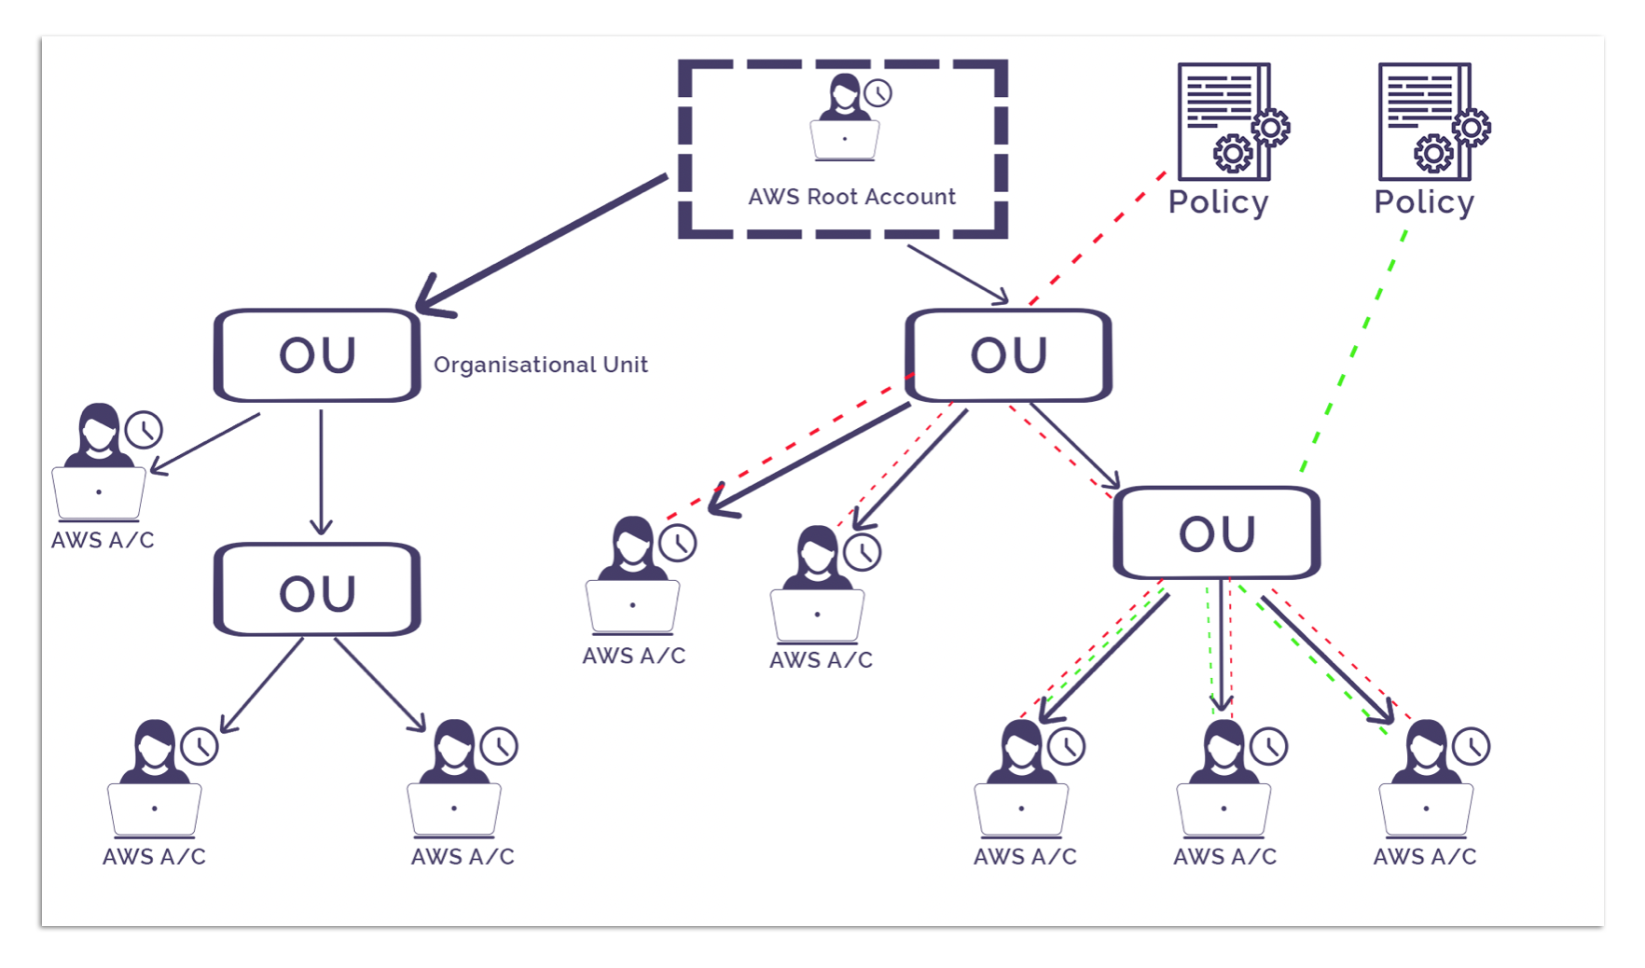
AWS ORGANIZATIONS
Centralized,policy based management for all AWS accounts

Slide 4

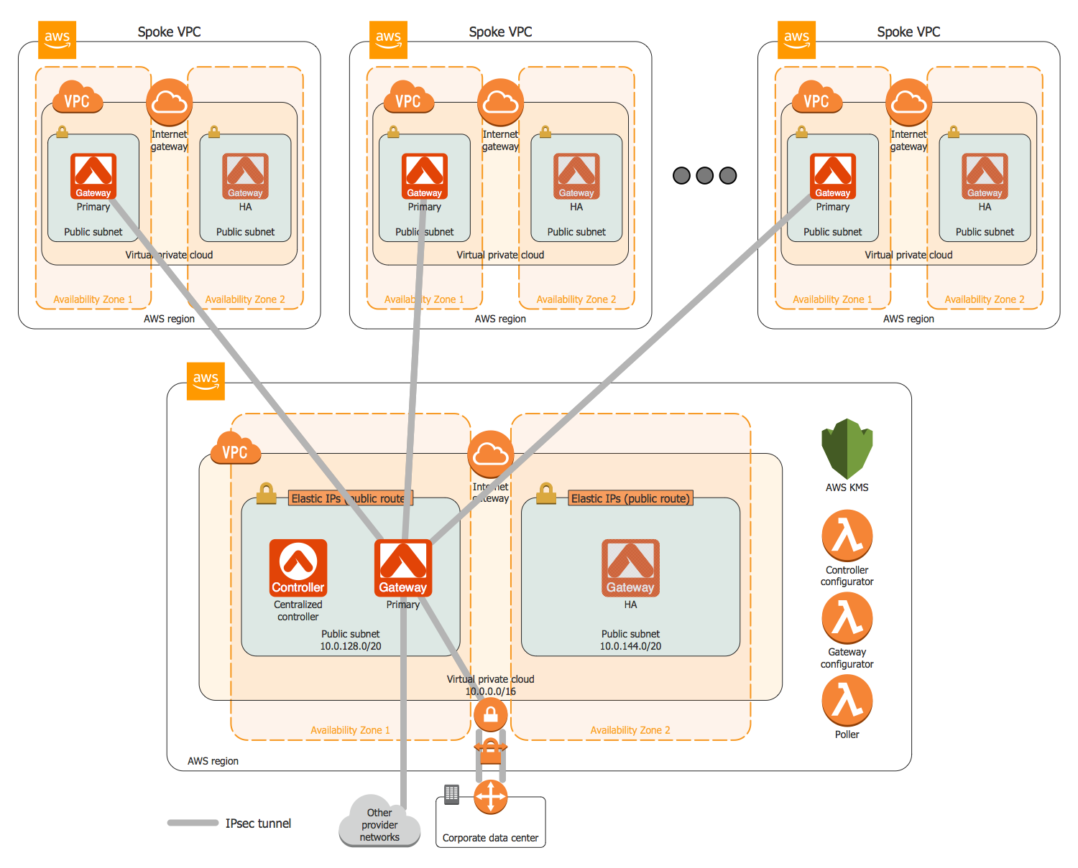
Hub and spoke model with Landing Zones
Infra provisioning using terraform
VPC peering
VPC peering
VPC peering
Spoke - Landing Zone
Reusability , Security & Scalability Of N/W resources

Slide 5
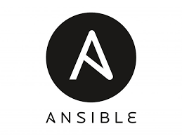


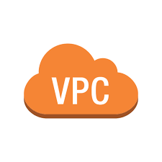

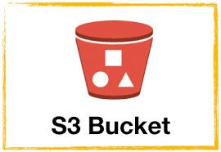

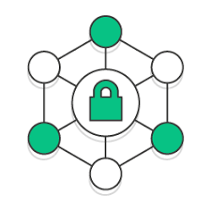


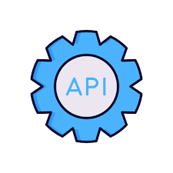

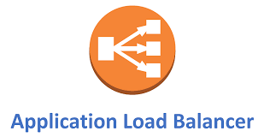




Creates VPC
Infrastructure & k8s configuration
Provision eks cluster
Region
Public Subnet
Private Subnet
Security Group
Public
EKS cluster
VPC Endpoint
L7 load balancer
Internet Gateway
Public DNS
Database upgrade
Route53
Nat Gateway
Availability Zone
Users
Reporting interface hosted on EKS

Slide 6
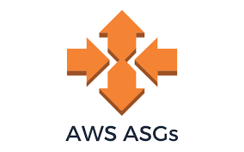
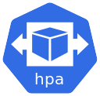

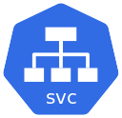
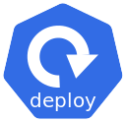
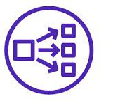

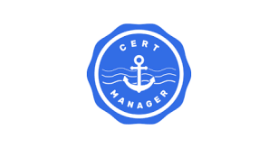
End to End encrypted connectivity
CLI comp- Intermediate pod
Type:ClusterIP
Report-gen app
Namespace:report-gen
L7 load balancer
ALB ingress controller
Route53
Internet Gateway
Open source k8s operator which provides ssl certs
Namespace: ingress-controller
Namespace:cert-mang

Slide 7
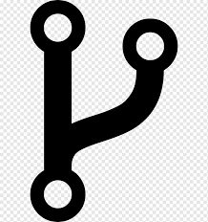
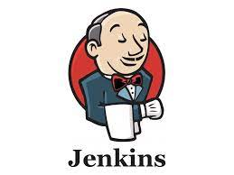

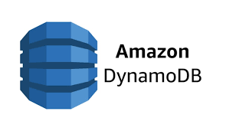
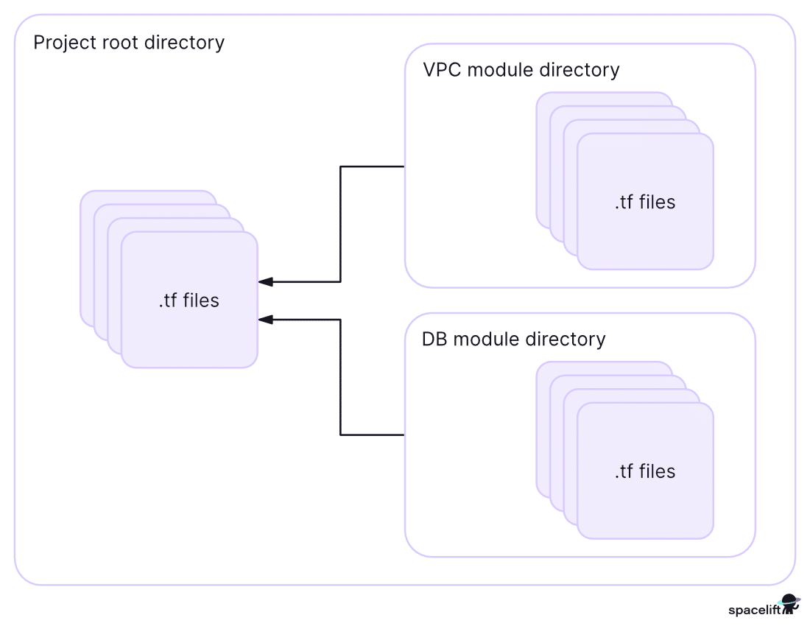





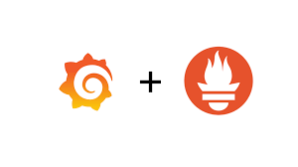


CI/CD Pipeline
Pulling source code
Services creates on AWS cloud
Remote state
Integrate
commit/push
S3 state bucket
Lock Table
Jenkins CI system
Public subnet
New Docker image push
New Docker image pull
Application Build
Docker image build
Docker img,Helm chart
Webhook trigger
Update GitOps repo with new Docker image info
Application code repository
Manifest sync Poll
Argo Namespace
App Namespace
Manifest Repo
Application development &commit/push
Commit/push the created manifest file
Developer
Ops
Create manifest file &chart.yaml,values.yaml

Slide 8
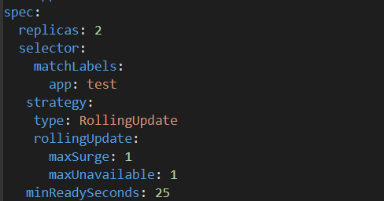
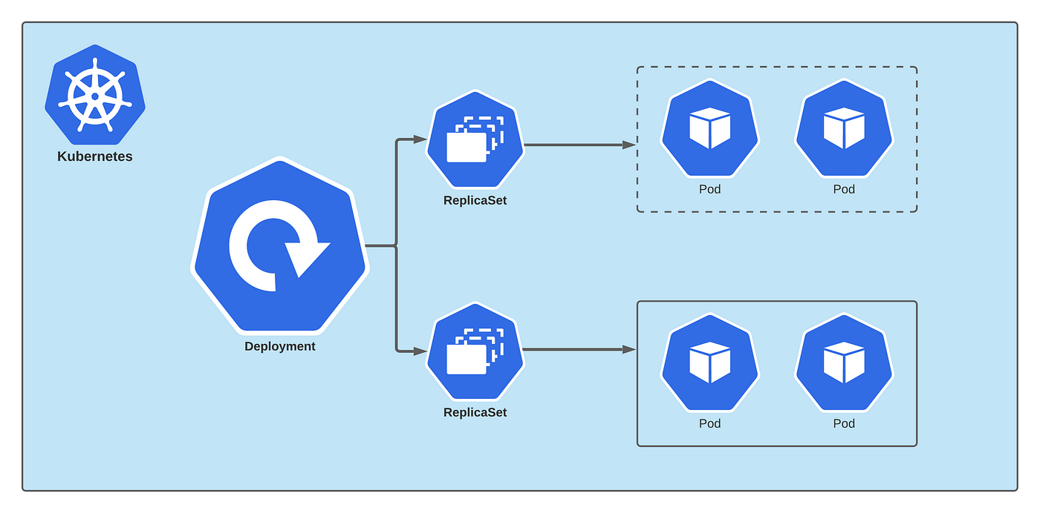
Deployment Strategy
Strategy Type:Rolling Update
High availability
Rollback capability
Gradual transition

Slide 9
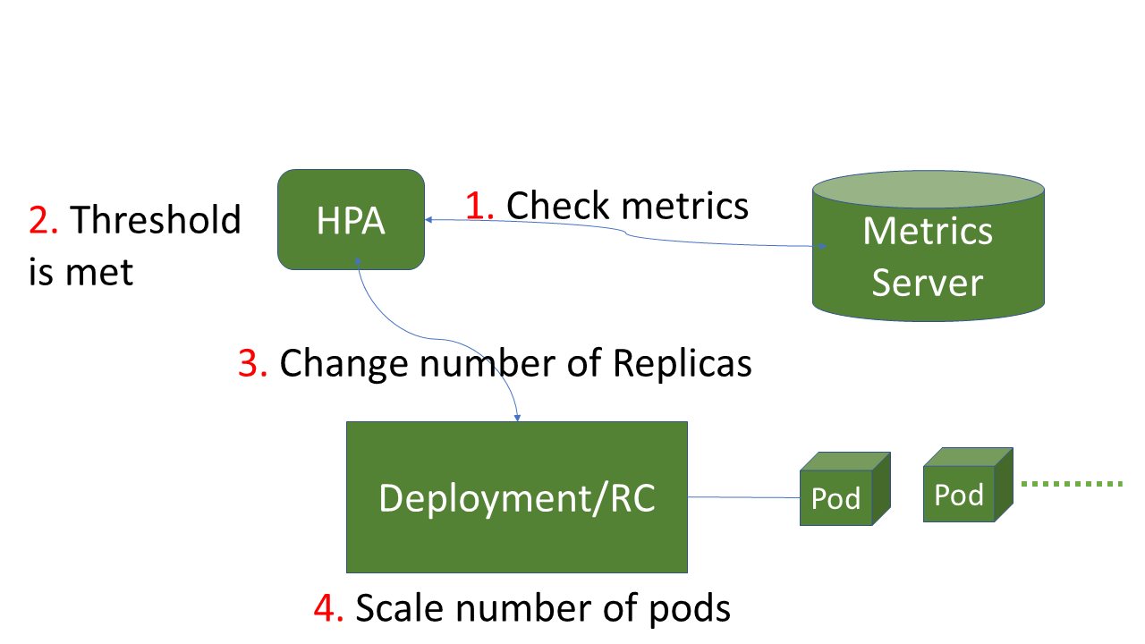
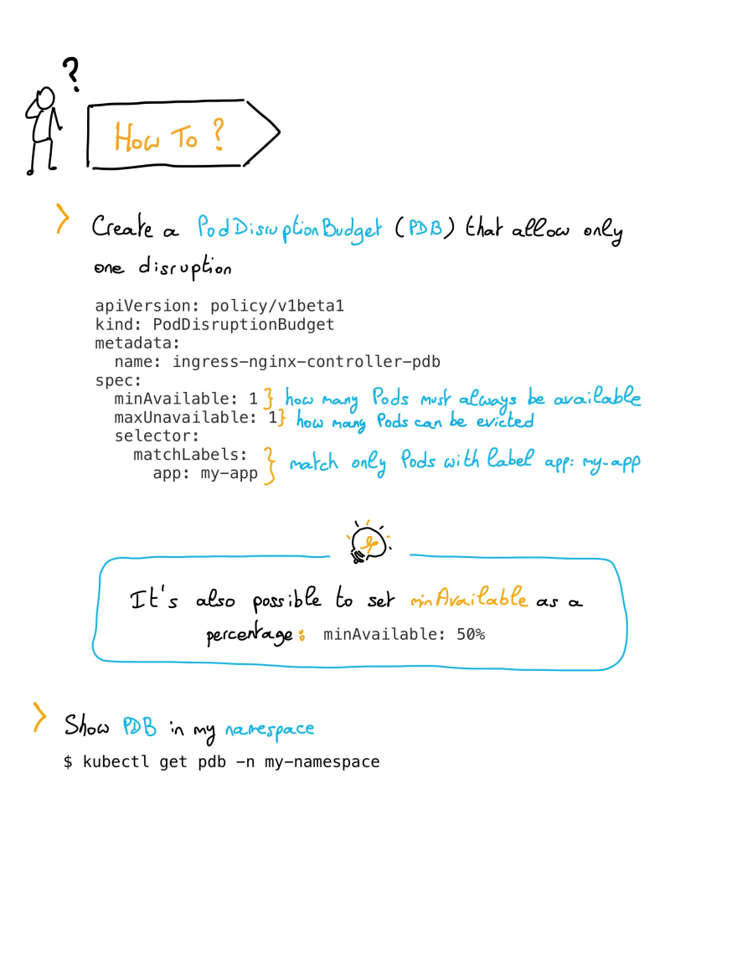
Scalability and Performance
CPU & memory metrics
Horizontal Pod Autoscaler (HPA)
Pod Disruption Budget (PDB)

Slide 10
Rollback mechanisms and Feedback loop
Automated Rollback Strategies:
Implement automated rollback strategies using ArgoCD's health checks or custom scripts.
Performance Monitoring with Prometheus:
Leverage Prometheus metrics to continuously monitor the performance and health of your system..
End-User Feedback and Issue Tracking:
Incorporating feedback mechanisms directly within application.
Feedback/complaint emails creating jira tickets automatically in support/Development queue

Slide 11
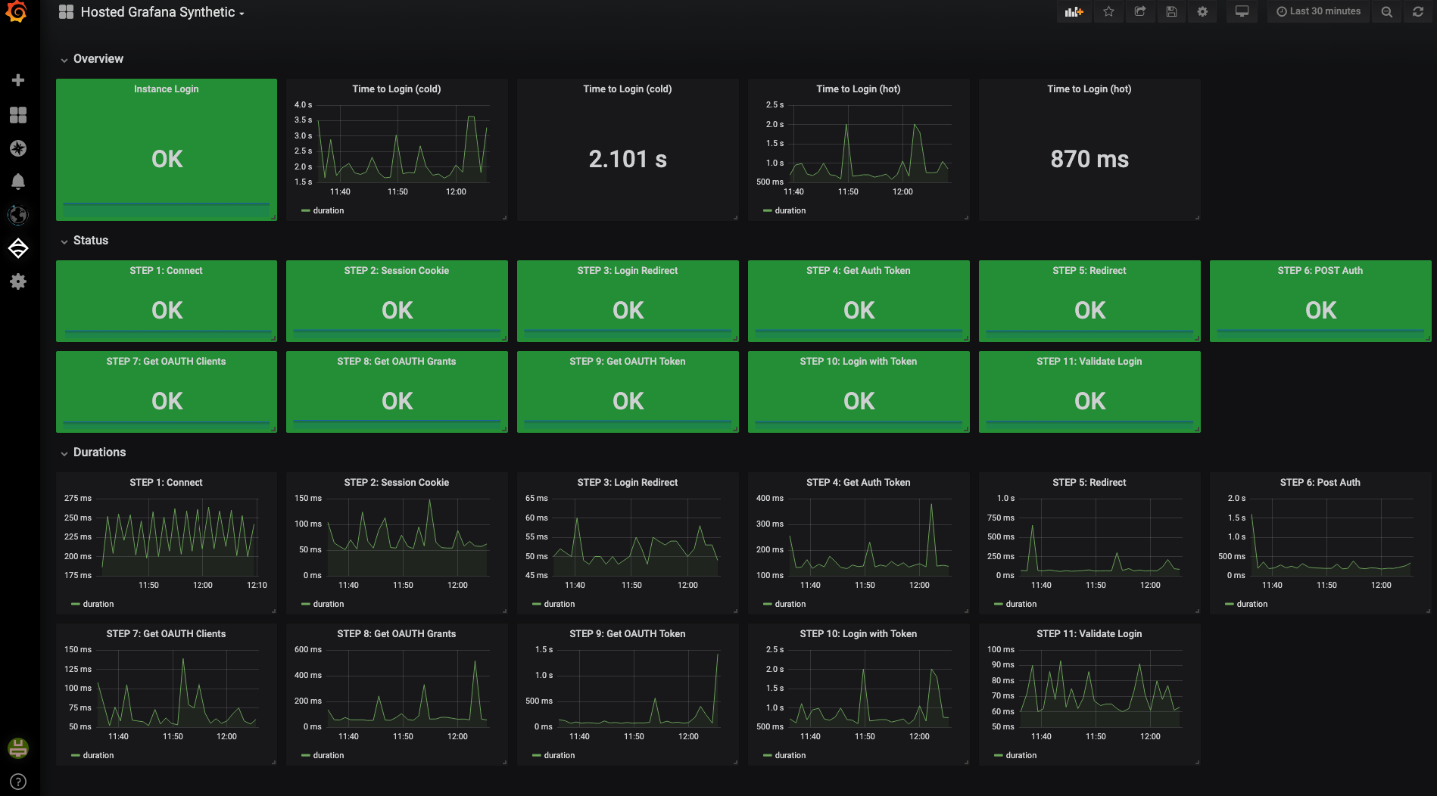
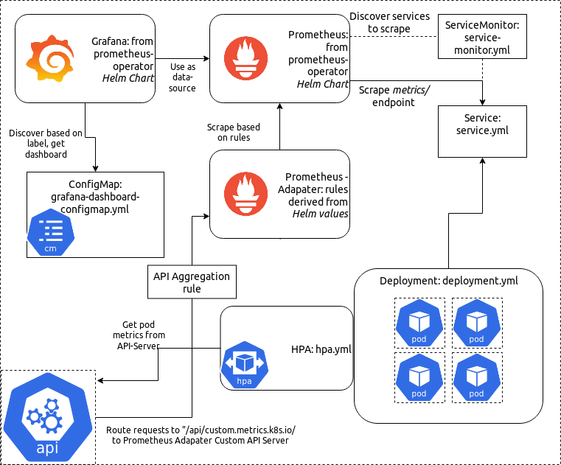


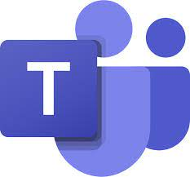
Notifications
Monitoring and Observability

Slide 12
Security & Compliance
Virtual Private Cloud (VPC)
Internet Gateway
VPC endpoint
Identity and Access Management (IAM)
Data Encryption ( Encryption in transit with https protocol by using ssl certificates)
Secret Management
Container Security
Logging(Splunk) and Monitoring
Incident Response and Recovery

Slide 13
THANK YOU !
Time for Q/A ?

